Slide 1



Sustainability of chatgpt
Andone Alexandru
German Maria-Alexia
Grigoras Ana-maria
Nema Alexandru
zota Ana-maria
Group 4
FHSTP

Slide 2
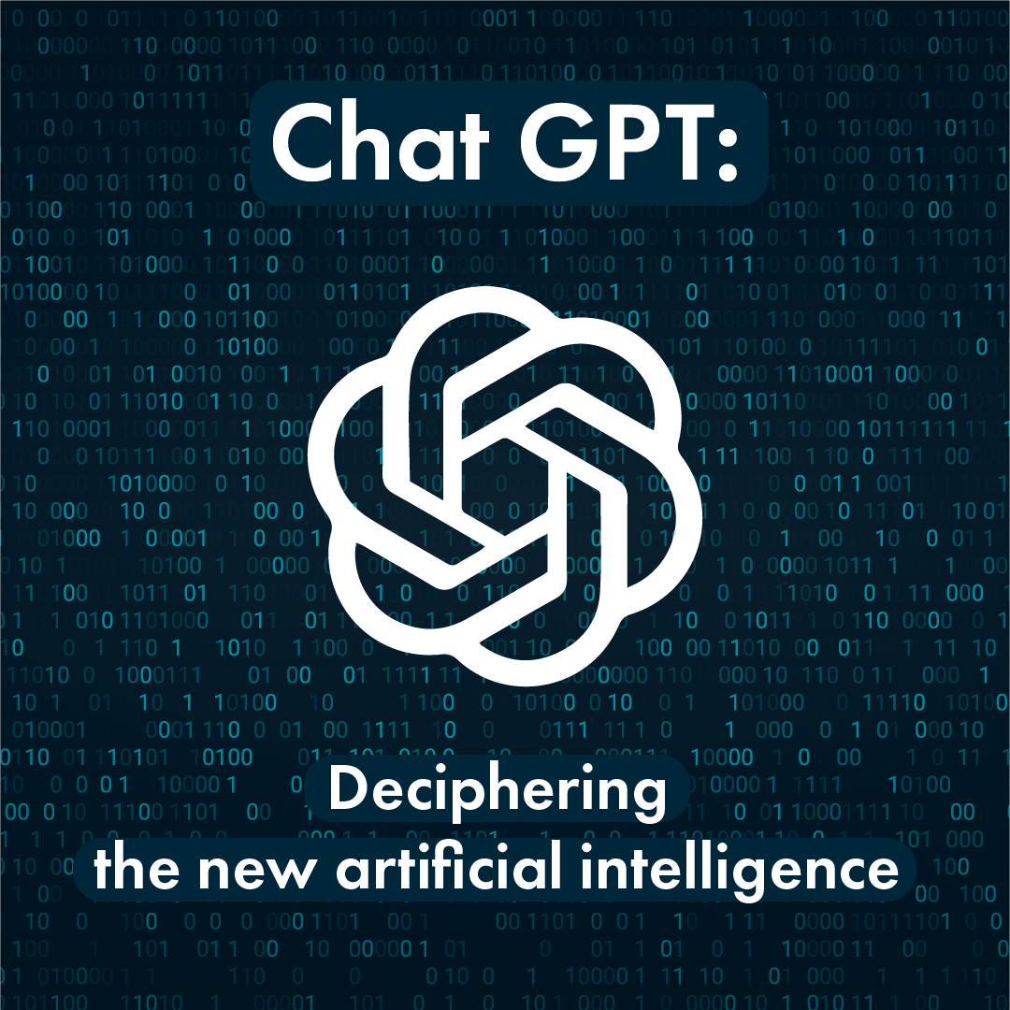
General Information
"Sustainable" in the context of ChatGPT refers to the long-term viability of the technology in terms of its energy consumption, environmental impact, and ethical considerations.
As a language model, ChatGPT requires significant amounts of computational power to function, which can contribute to carbon emissions and other negative environmental impacts.
Additionally, there are ethical concerns around the potential misuse of the technology, such as the spread of misinformation or the reinforcement of harmful biases.

Slide 3

Complex problem solving steps
Clarify the problem: ChatGPT's current operations and usage are unsustainable due to their energy consumption and potential negative impacts on the environment and society.
Identify the causes: The main causes of ChatGPT's unsustainability are its reliance on energy-intensive computing resources, such as data centers and GPUs, and the lack of ethical guidelines and oversight around its use.
Develop solutions: Some potential solutions to make ChatGPT's operations and usage more sustainable include optimizing its algorithms to reduce energy consumption, using renewable energy sources to power its computing resources, and implementing ethical guidelines and oversight to prevent misuse.
Implement solutions: These solutions would need to be implemented by the developers and stakeholders of ChatGPT, and may require changes to the technology's architecture and infrastructure, as well as collaborations with renewable energy providers and ethical experts.

Slide 4
Researched Data:
According to a study by researchers at the University of Massachusetts Amherst, training a large language model like GPT-3 can emit as much as 626,000 pounds of carbon dioxide equivalent, which is roughly equivalent to the lifetime emissions of five average American cars.
Additionally, a report by OpenAI, the developer of ChatGPT, acknowledges the potential for the technology to reinforce harmful biases and spread misinformation.

Slide 5
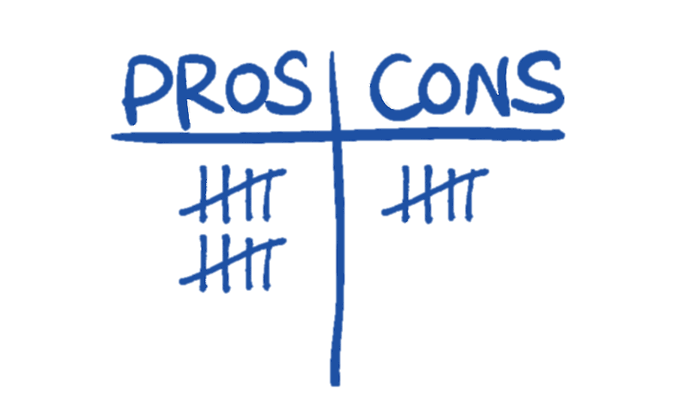
Biases and Pitfalls:
Bias can be defined as any systematic error in the design, conduct, or analysis of a study. Otherwise, a pitfall is an unexpected danger or difficulty.
One potential bias in this analysis is a lack of consideration for the benefits of ChatGPT, such as its ability to generate new insights and facilitate communication.
Additionally, there may be limitations in the feasibility and effectiveness of the proposed solutions, as they may require significant investments and changes to the technology's infrastructure.

Slide 6

Assumptions and Open Questions:
Assumptions
Open Questions
One assumption is that the developers and stakeholders of ChatGPT are committed to making the technology more sustainable and ethical.
An open question is whether the proposed solutions can be effectively implemented and scaled up to address the sustainability and ethical concerns of ChatGPT.
What are the most effective ways to reduce carbon emissions? How will it affect the population?

Slide 7

Thank you for your attention!

